Slide 1

Designing Sensor Systems
MSc Systems Engineering for Internet of Things
MED ASSIST
Karim Hammoud Dongjie Li Adityo Mukti Yating Yang

Slide 2





MED ASSIST
How can we implement an IoT solution in medicine?
How can we help hospitals run smoother and more efficiently?
In what areas can hospitals benefit from IoT solutions without hindering their work?

Slide 3
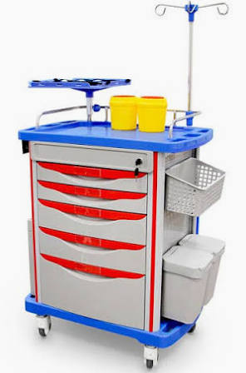
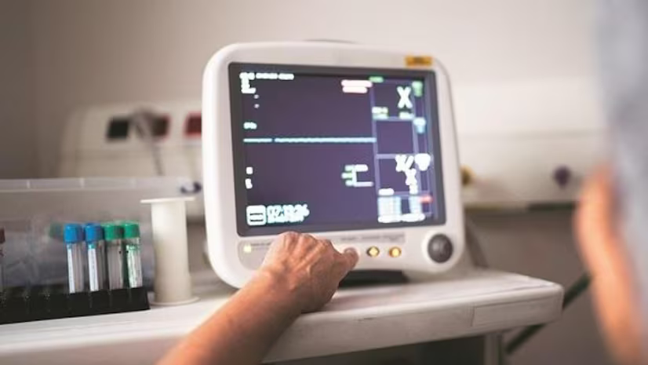
MED ASSIST
Main Features
Intelligent management of emergency trolley contents
Supervision of crucial medical devices’ readings/parameters
Ward environment detection and monitoring
Automatically move to the required position to be refilled the contents if summoned
All data available on cloud

Slide 4
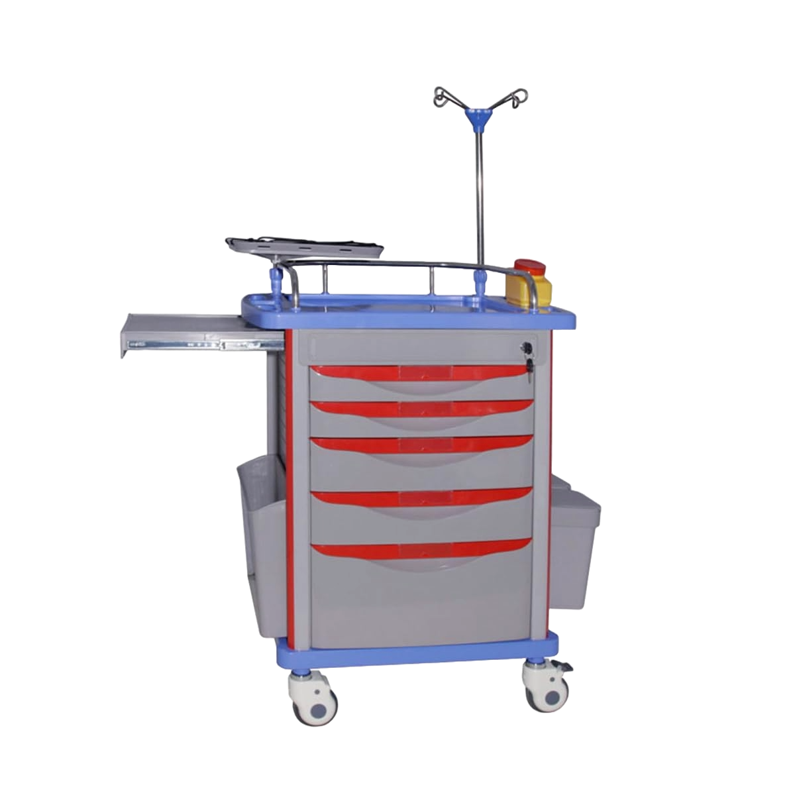
MED ASSIST
S
Smart Crash Carts
W
Real-time monitoring
Automated alerts
Efficient resource allocation based on data
Data analytics
Potential failures causes delay responses
Technical expertise
Uncertainty in hospital
Improved patient care
Efficient resource management
Integration with other systems
Security concern
Technology adoption resistance
Regulatory compliance
O
T

Slide 5
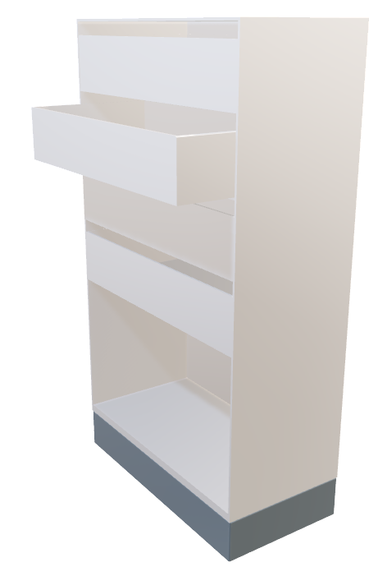
MED ASSIST
A smart organised and mobile storage unit for essential equipment.
Used in every emergency room with the hospital reducing patient care time and therefore increasing efficiency.

Slide 6
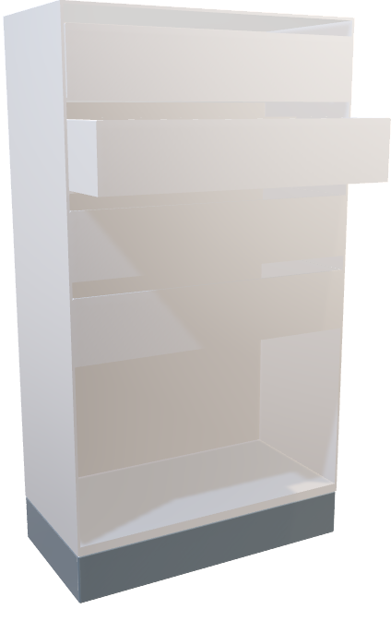
MED ASSIST
Communication and perception
Detection of medical equipment
Capable of manoeuvring around the environment if needed

Slide 7
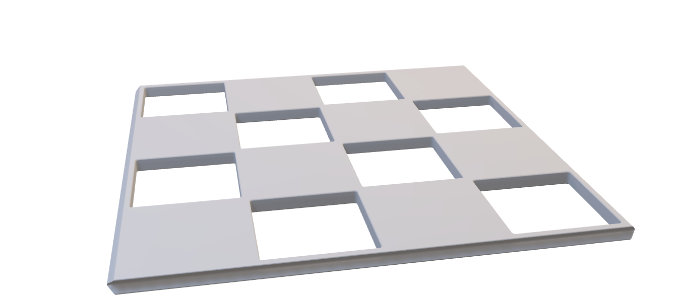
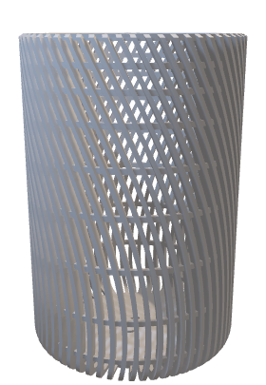
MED ASSIST
An array of pressure sensors on each board enable the detection of any change.
These sensors operate using the piezoelectric effect correlating any change in resistance to change in weight.
Voltage measurement is then analysed and information is updated to the system
Vibration sensors with and actuator
Range sensors
Touch sensors / weight sensors
Other sensor possibilities?

Slide 8
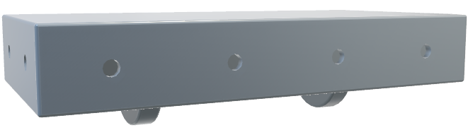
MED ASSIST
Proximity sensors
Docking for charging
2 wheels drive
Lidar sensors
Lights for indications
Odometry

Slide 9
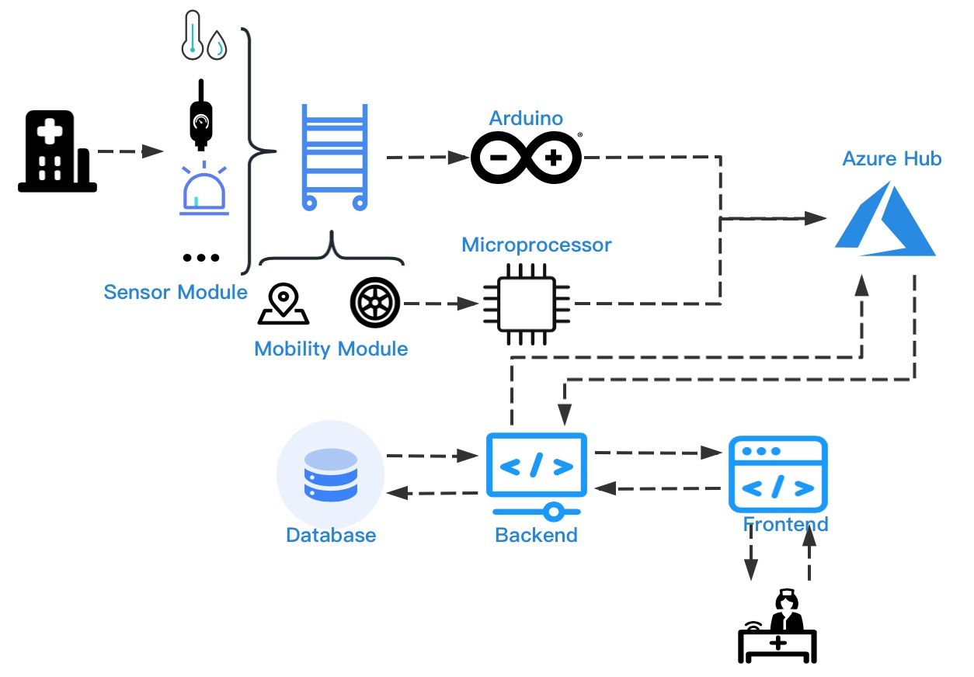
Software Architecture
Trolley equipped with different sensors will collect environmental data from the wards as well as its own position.
Collected data will be transmitted wirelessly to Azure cloud platform.
Microprocessor will conduct preliminary data processing to provide support for movement.
Implement business logic and data processing through the backend and provide a user-friendly frontend for nurses.

Slide 10
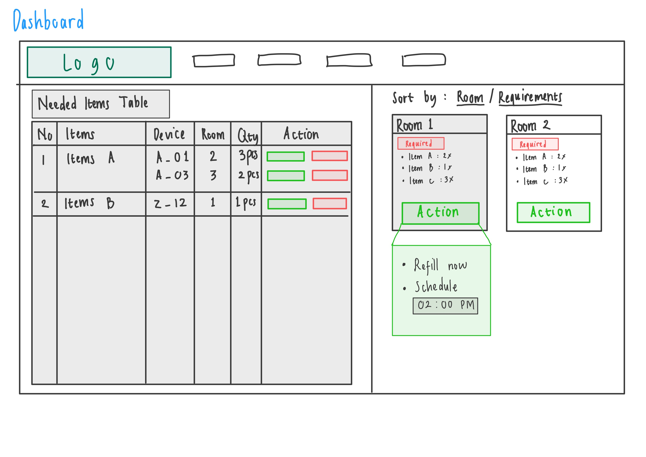
Low Fidelity Prototype
Trolley equipped with different sensors will collect environmental data from the wards as well as its own position.
Collected data will be transmitted wirelessly to Azure cloud platform.
Microprocessor will conduct preliminary data processing to provide support for movement.
Implement business logic and data processing through the backend and provide a user-friendly frontend for nurses.

Slide 11
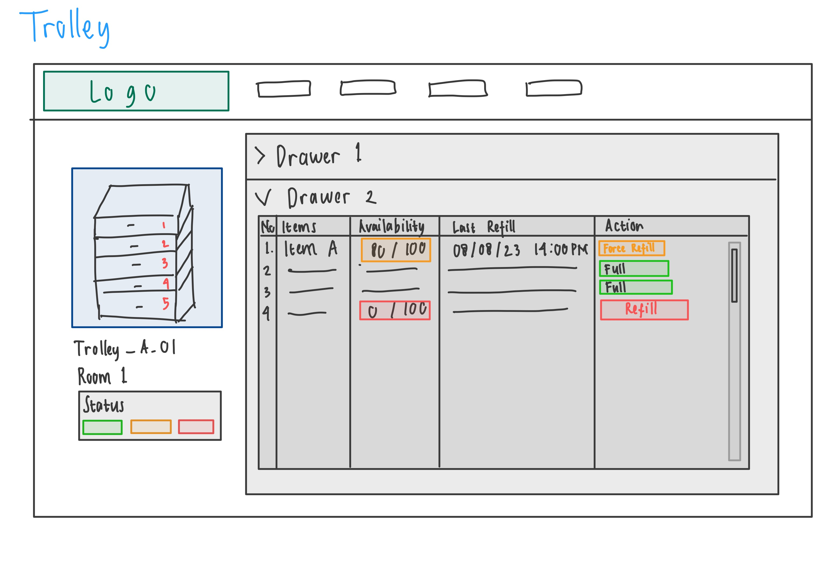
Low Fidelity Prototype
Trolley equipped with different sensors will collect environmental data from the wards as well as its own position.
Collected data will be transmitted wirelessly to Azure cloud platform.
Microprocessor will conduct preliminary data processing to provide support for movement.
Implement business logic and data processing through the backend and provide a user-friendly frontend for nurses.

Slide 12
MED ASSIST
1 Nov.
finalize parameters
1 Dec.
Hardware version 1 low resolution prototype
1 Feb.
Implement necessary software and control
1 Mar.
Test on high resolution prototype

